Slide 1


Storyboard Assignment
Adam Miszkiewicz
Comp3023-Winter2025
200547405

Slide 2

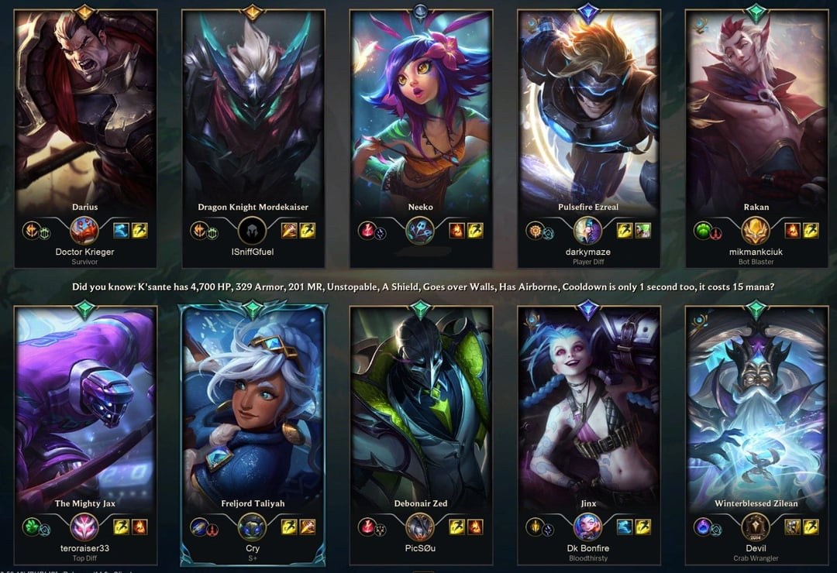
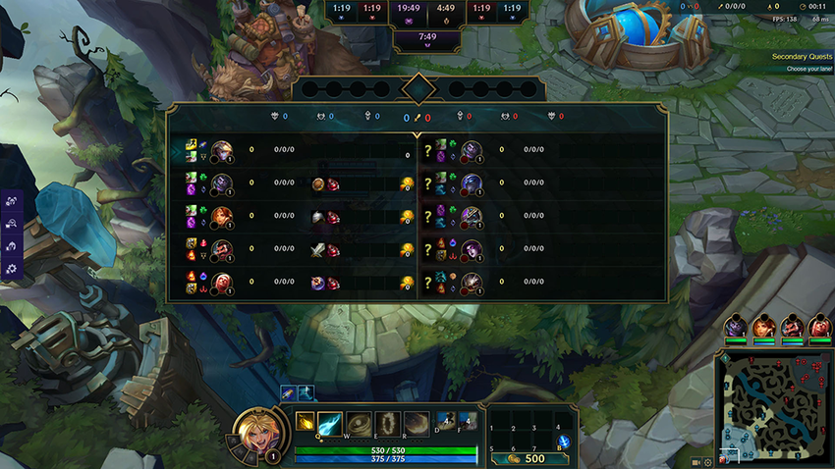
General Game Rules
Two teams of five players face off in a 5v5 battle.
Each player controls a unique champion with distinct abilities.
The primary objective is to destroy the enemy’s Nexus (the core of their base).
Players earn gold by defeating minions and enemies to buy items.
Use gold to purchase gear, earn EXP to level up new abilities.

Slide 3
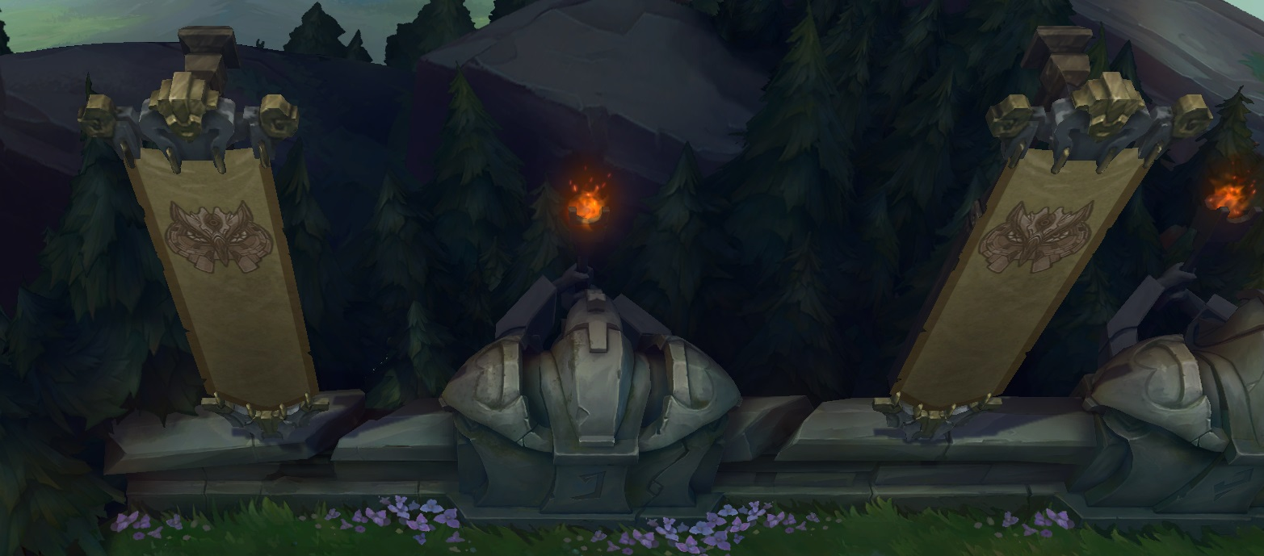
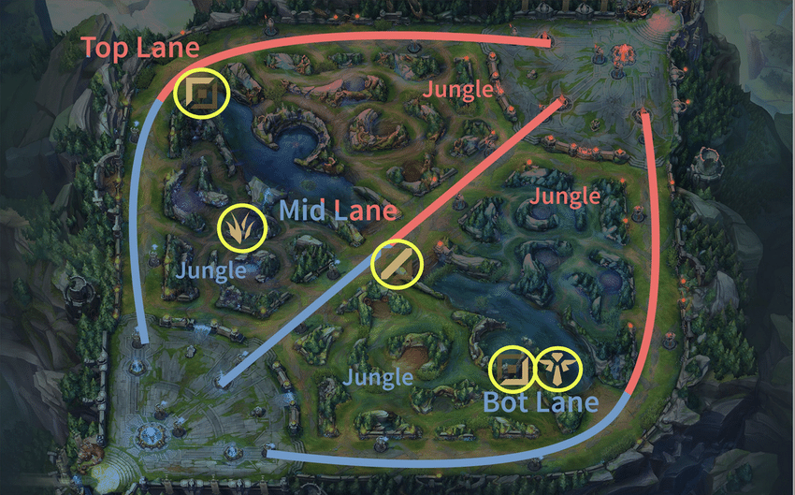
Setting and Environment - Summoner’s Rift
The game is set on Summoner's Rift, a mystical and large arena divided into three main lanes (Top, Mid, Bottom).
The lanes are bordered by towers, turrets, and inhibitors that protect each team's Nexus.
The jungle area is filled with neutral monsters and objectives like Dragon, Baron Nashor, and Rift Herald, offering strategic advantages.
Day and night cycles in the game influence the environment and the visibility on the map.

Slide 4
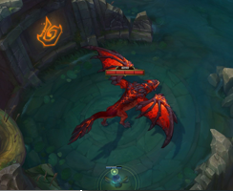
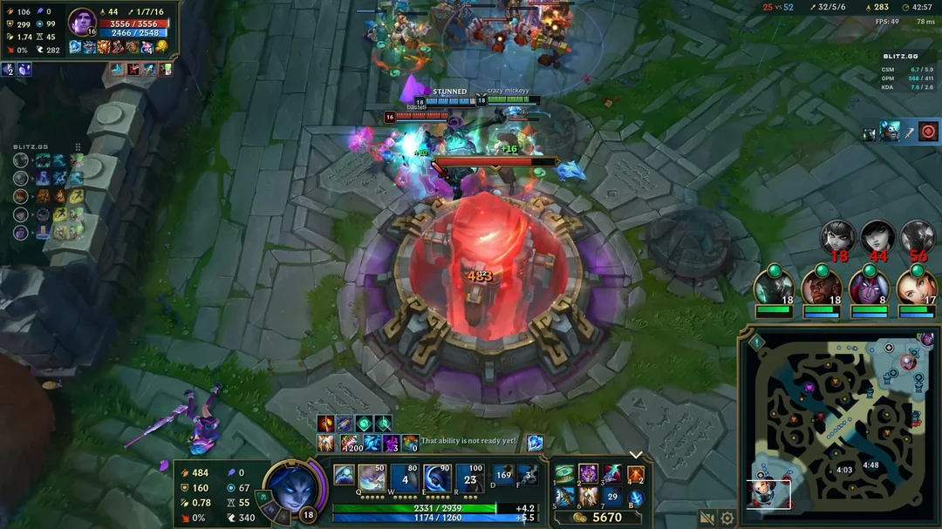
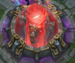
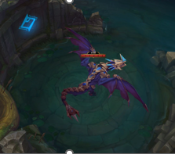
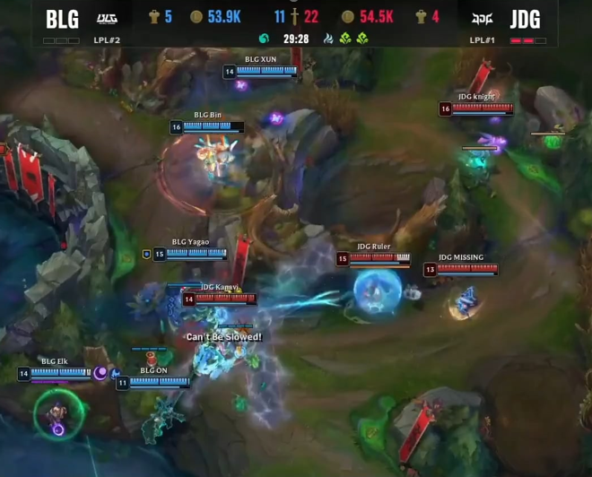
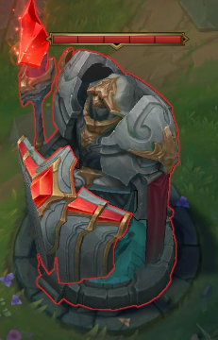
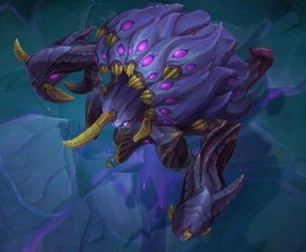

Game Goals & Objectives
The goal is to destroy the enemy team’s Nexus while defending your own.
Destroy enemy defenses, secure objectives, gain gold & experience.
Strategize to defeat opponents, complete objectives, and level up champions.

Slide 5
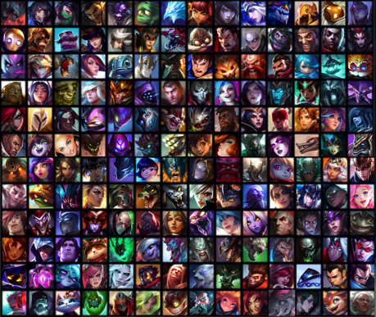





Champions
Vast roster of champions, each with unique abilities, roles, and playstyles.
Players select a champion, each with strengths and weaknesses
Each champion has unique abilities and ultimate moves
Assassin
Fighter
Mage
Marksman
Support

Slide 6
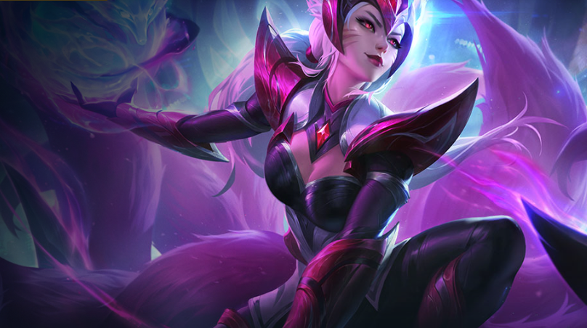



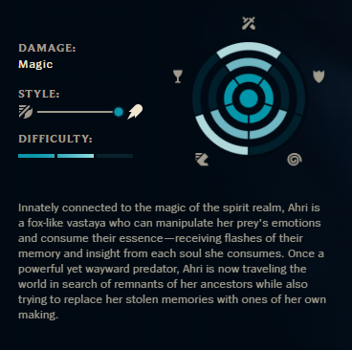
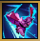

Ahri, the Nine-Tailed Fox
Ahri sends out a pulls back her orb, dealing magic damage on the way out and true damage on the way back.
Orb of Deception
Q
Ahri gains a brief burst of Move Speed and releases three fox-fires, that lock onto and attack nearby enemies.
Fox-Fire
W
Ahri blows a kiss that damages and charms an enemy it encounters, instantly stopping movement abilities and causing them to walk harmlessly towards her.
Charm
E
Ahri dashes forward and fires essence bolts, damaging nearby enemies. Spirit Rush can be cast up to three times before going on cooldown and gains additional recasts when taking down enemy champions.
Spirit Rush
R
After killing 9 minions or monsters, Ahri heals. After taking down an enemy champion, Ahri heals for a greater amount.
Essence Theft
Passive

Slide 7
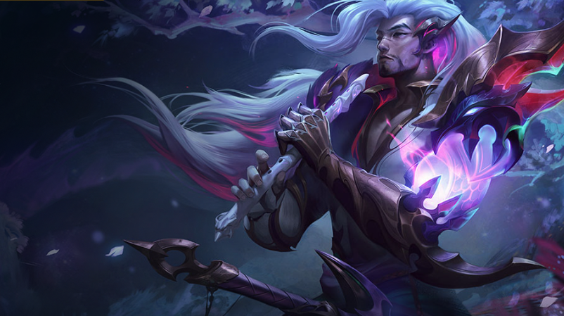



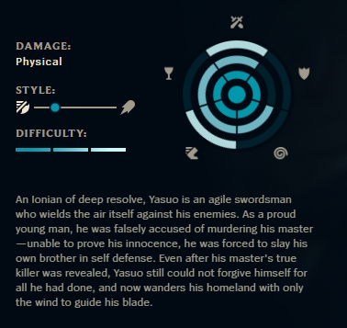


Yasuo, The Unforgiven
Thrusts forward, damaging all enemies in a line. On hit, grants a stack of Gathering Storm for a few seconds. At 2 stacks, Steel Tempest fires a whirlwind that knocks Airborne.
Steel Tempest
Q
Creates a moving wall that blocks all enemy projectiles for 4 seconds.
Wind Wall
W
Dashes through target enemy, dealing magic damage. Each cast increases subsequent dash’s damage, up to a max amount. Cannot be re-cast on same enemy for few seconds.
Sweeping Blade
E
E
Blinks to an Airborne enemy champion, dealing physical damage and holding Airborne enemies in the area in the air.
Last Breath
R
Yasuo’s Critical Strike Chance is increased. Additionally, Yasuo builds toward a shield whenever he is moving, shield is triggered when damage is taken
Way of The Wanderer
Passive

Slide 8
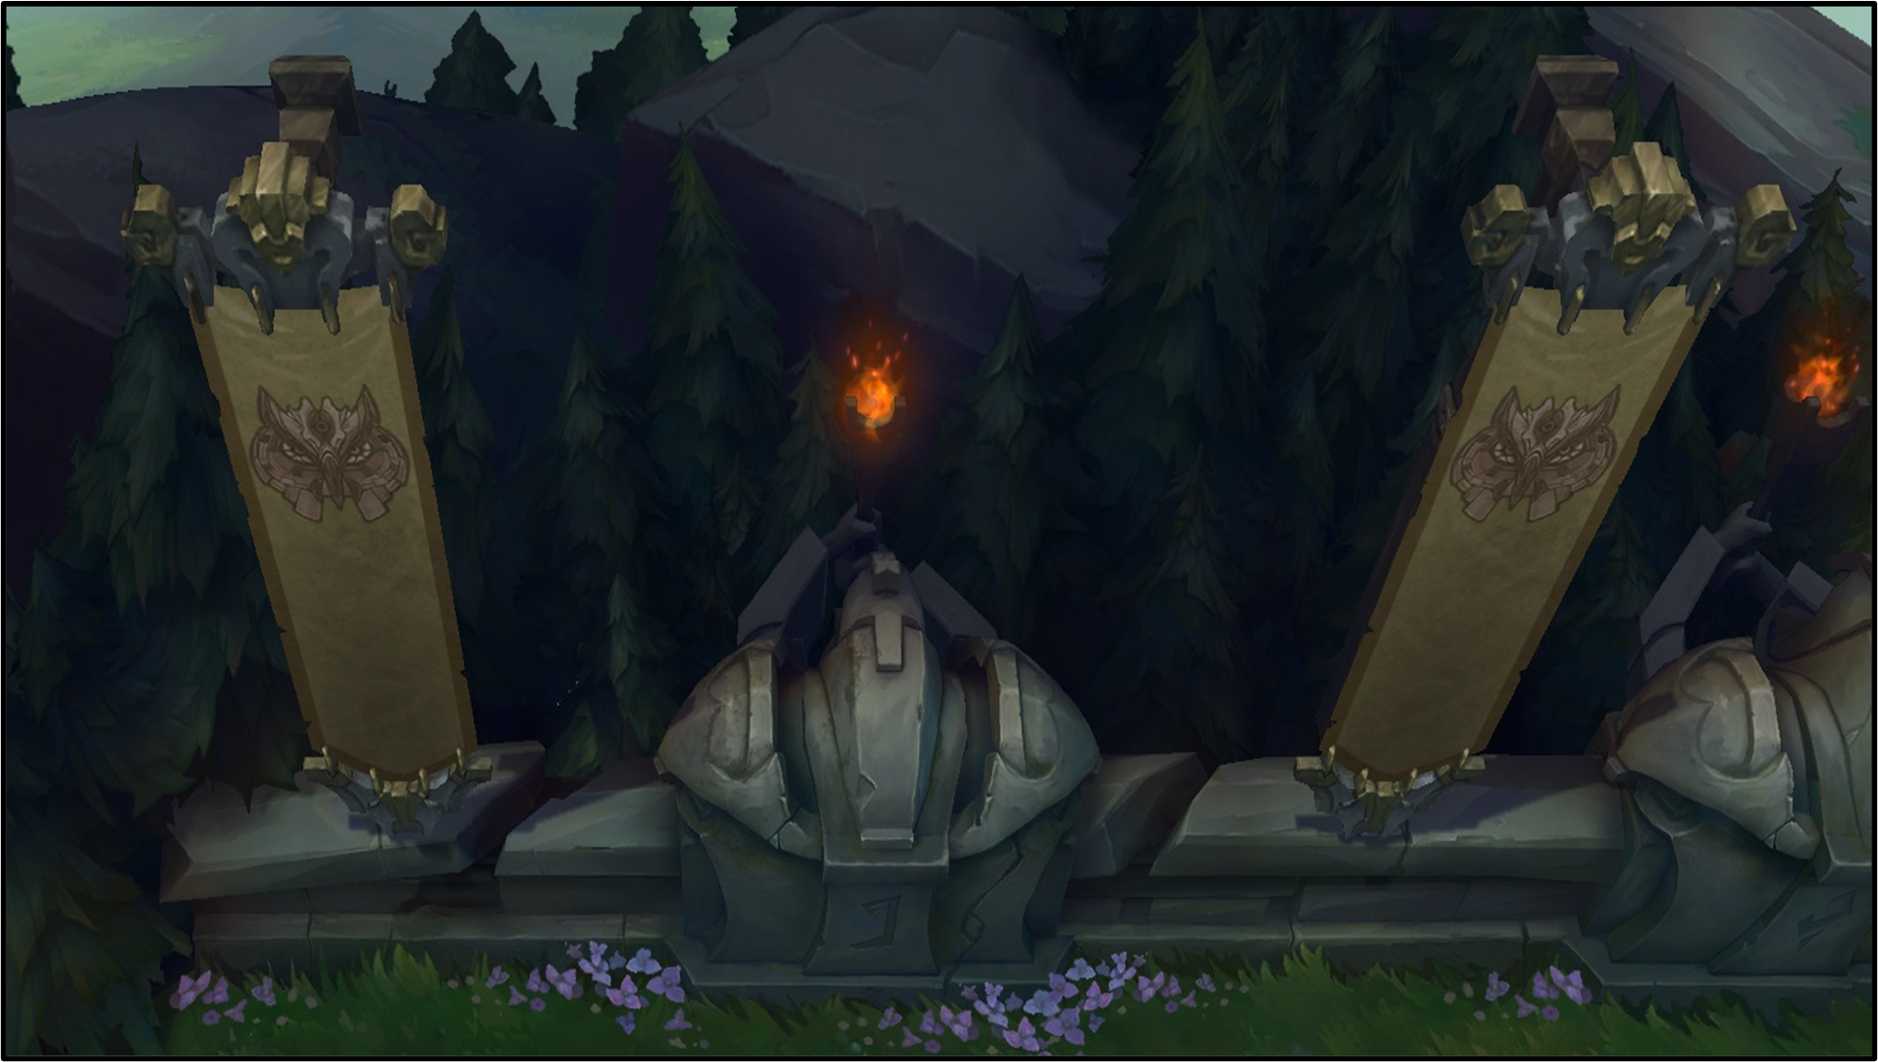
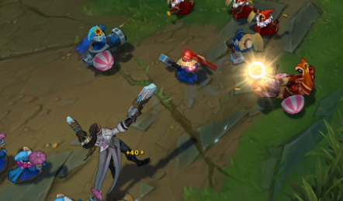
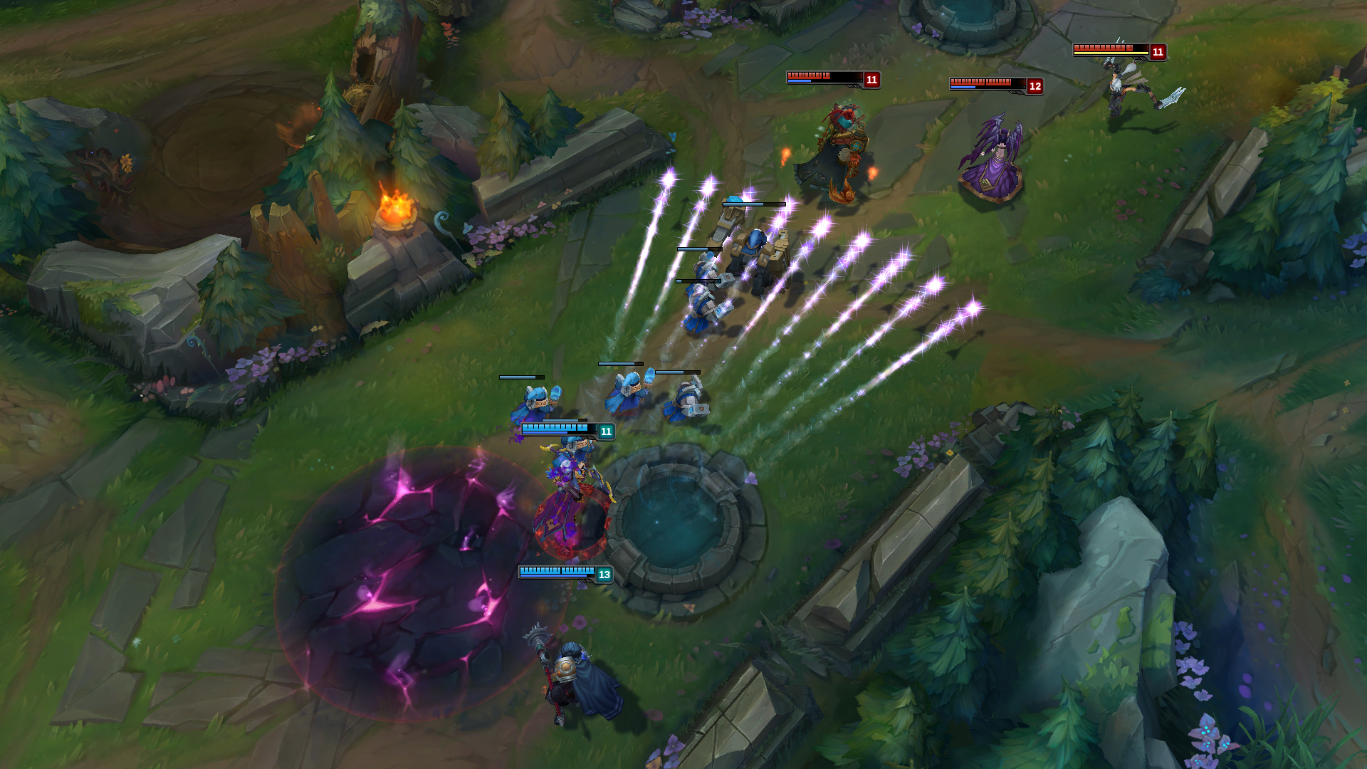
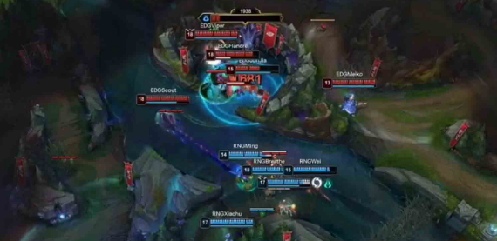
Game Levels and Progression
Progression occurs in 3 stages: Early Game, Mid Game, Late Game.
Early Game: Players focus on farming minions, securing jungle objectives, and gaining experience and gold.
Mid Game: Teams begin engaging in larger skirmishes and securing major objectives like Dragon and Rift Herald.
Late Game: The focus is on team fights, major objectives like Baron Nashor, and pushing towards the enemy Nexus.

Slide 9
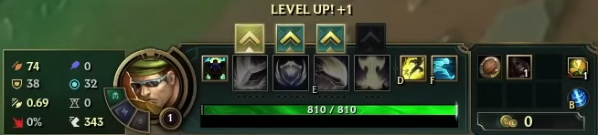
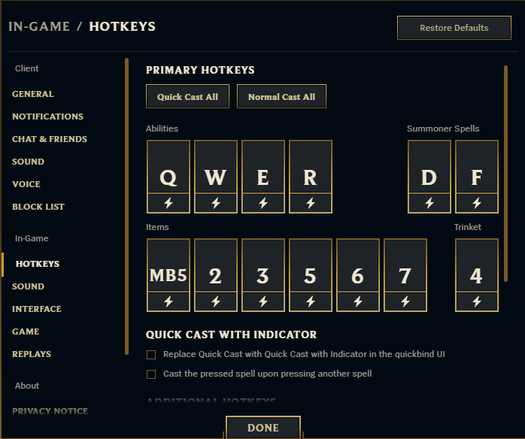
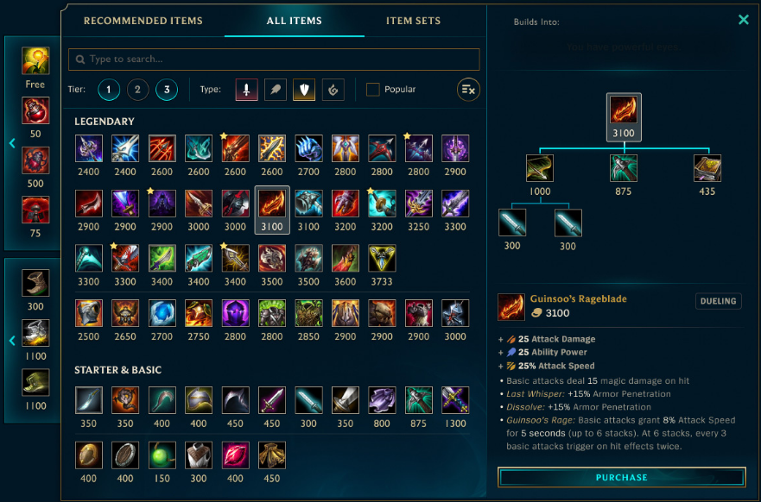
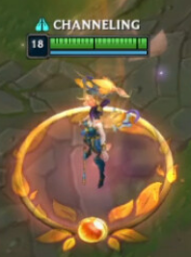
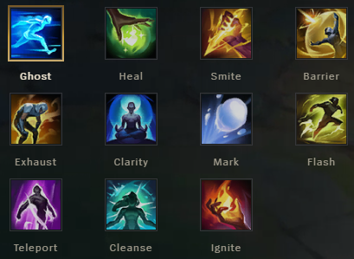
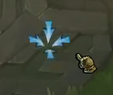

Game Controls & Mechanics
Default Hotkeys -
(Q, W, E, R)
Hotkeys ( Q, W, E, R) are used to activate abilities.
Base shop access
Hotkey – (P)
Left-click to move character
Default Summoner spell Hotkeys –
(D, F)
Right-click to attack or use abilities
Recall to base Hotkey – (B)

Slide 10
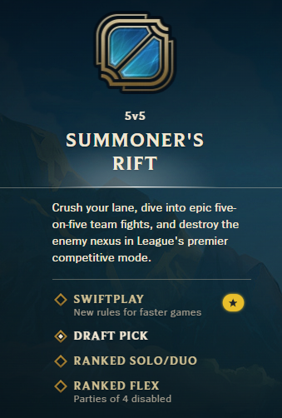
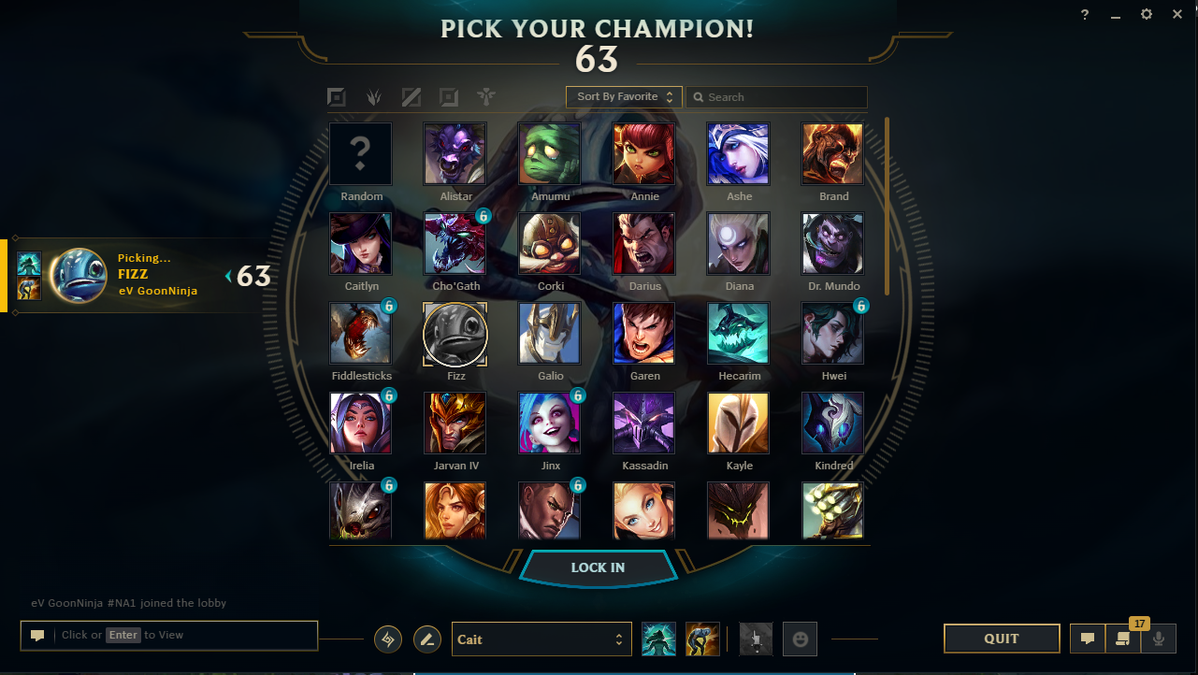
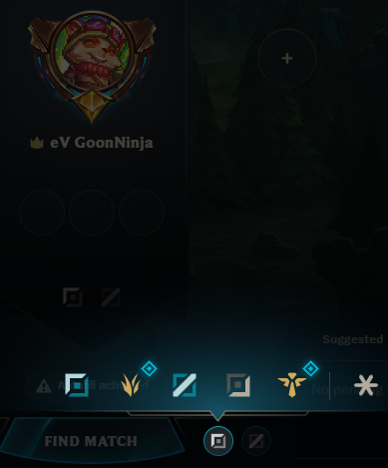
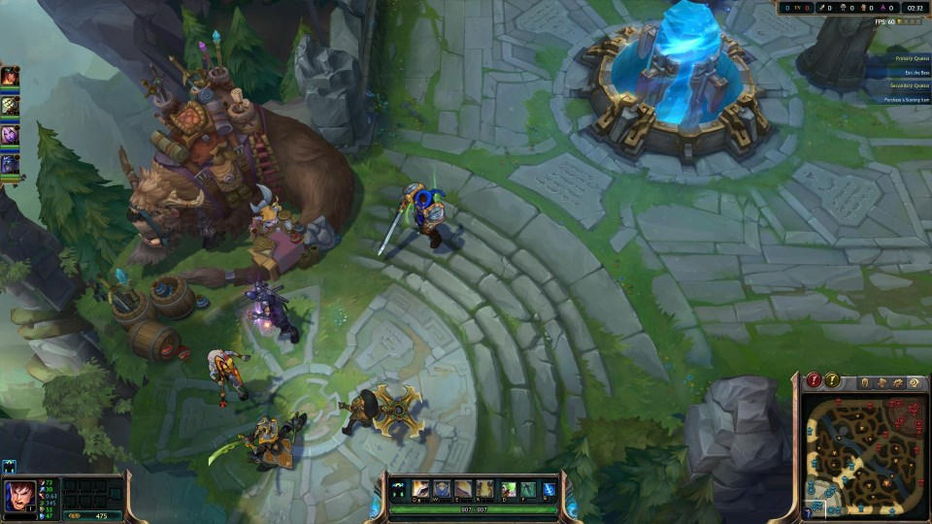
Starting the Game
Select Role
Load into game & play!
Pick Champion & Runes
Select Game Mode

Slide 11
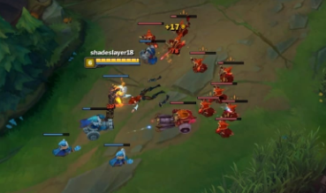
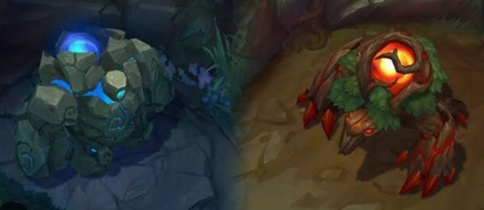
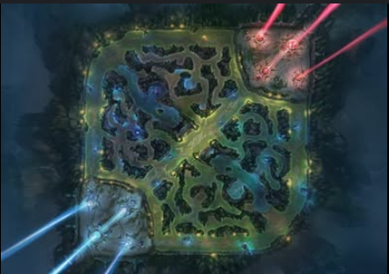
Early Game
Junglers roam the jungle, killing neutral monsters for gold and assisting lanes with ganks (ambushes).
Laning phase: Players position themselves in the Top, Mid, or Bottom lanes and aim to harass the enemy while avoiding being killed.
In the early game, players focus on last-hitting minions for gold and experience.

Slide 12
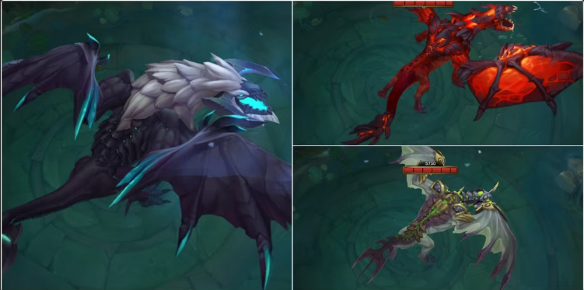
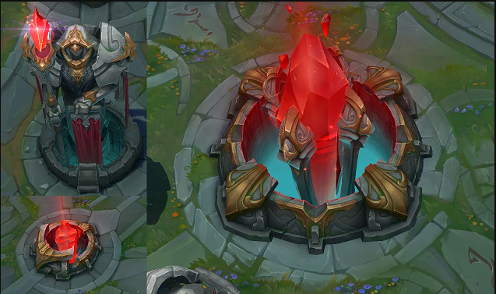
Mid Game
Players start grouping together to contest objectives like Dragon or Rift Herald.
Mid game is often marked by skirmishes and increased team interactions, focusing on getting kills and pushing towers.

Slide 13
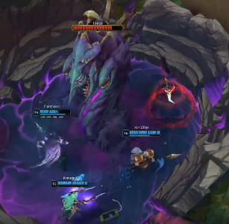
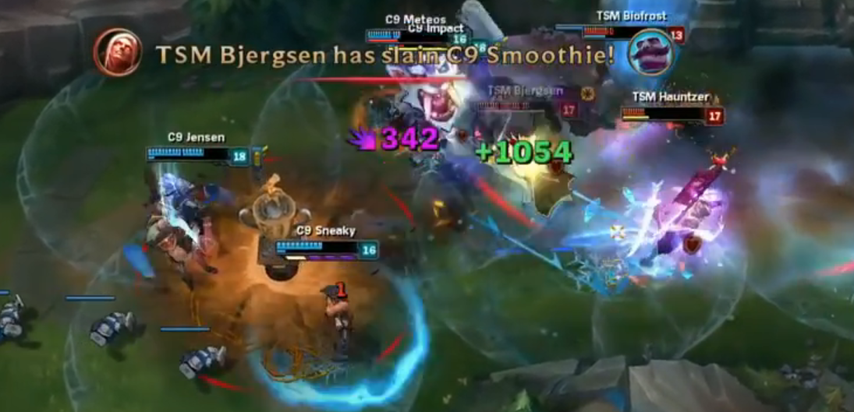
Late Game
In the late game, players will often group for large team fights, trying to secure objectives like Baron Nashor and pushing the enemy’s inhibitors.
Team fights are crucial for securing an advantage and advancing toward the Nexus.

Slide 14
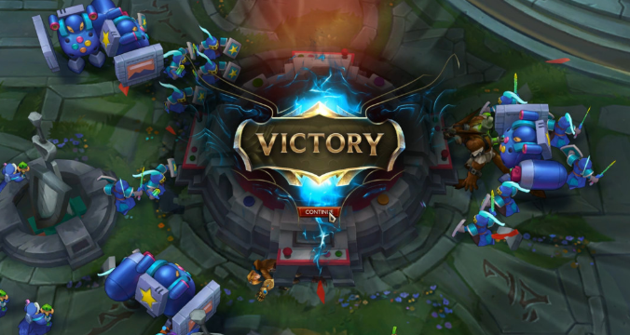
Conclusion
League of Legends offers a dynamic and strategic experience, with constant updates, balance changes, and competitive play.
This game combines teamwork, strategy, and individual skill, ensuring a highly engaging and competitive environment.
Adam Miszkiewicz
Comp3023-Winter2025
200547405

